Slide 1
Linear Revision
A reminder of what you should have learnt last year! ☺

Slide 2
I Suggest you rule up cornell notes
Topic: Linear Revision
EQ: How much do I remember about linear relationships?

Slide 3

The linear equation
The General equation for a linear function is:
$$y=mx+c$$
y intercept
Gradient

Slide 4
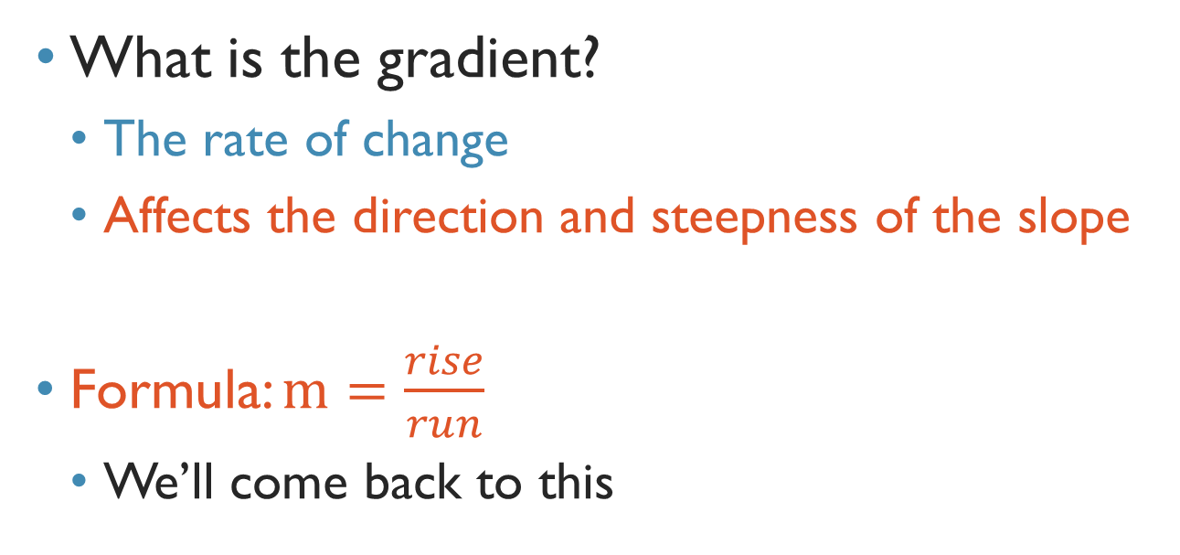
Gradient
What is the gradient?
The rate of change
Affects the direction and steepness of the slope
Formula: $m=\frac{rise}{run}$
We’ll come back to this
GLOSSARY ALERT

Slide 5
Gradient
A positive gradient gives a positive slope:
m>0
A negative gradient gives a negative slope
m<0

Slide 6
Gradients
The greater the |gradient| the steeper the slope:
The smaller the |gradient| the flatter the slope:
GLOSSARY ALERT
|x| → the straight line brackets mean we are considering the absolute value, which is the distance from zero

Slide 7
Gradients
Undefined gradient:
Zero gradient:

Slide 8
Estimate the gradient
State whether the gradient is negative or positive and whether its absolute value is high or low:

Slide 9
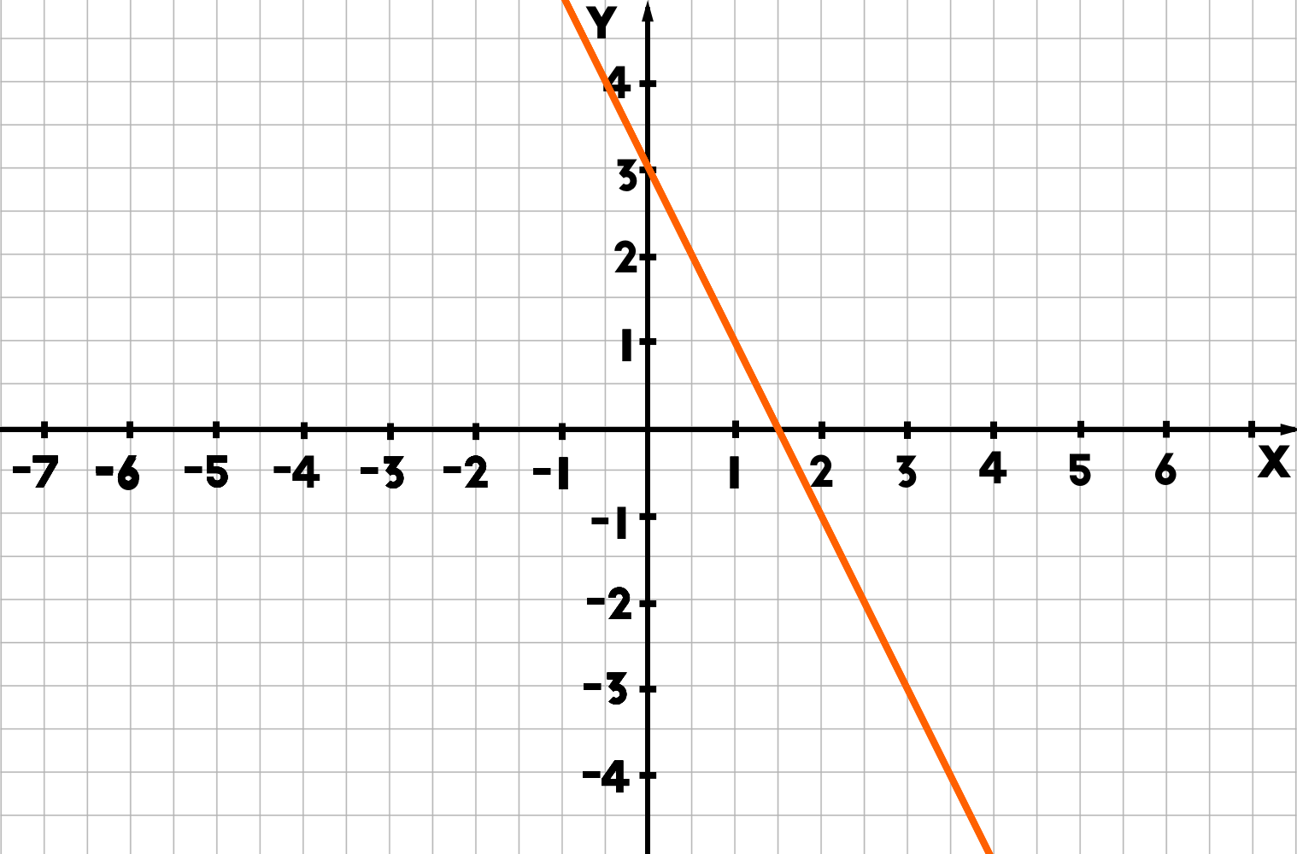
Y intercept
The y intercept is the point where the line crosses the y axis
Where x = 0
In this case the y intercept =
(0,3)
GLOSSARY ALERT

Slide 10
Table of values
x | 0 | 1 | 2 | 3 | 4
y
Fill in a table of values for the following linear equations:
y=4x+7
y=-2x+3
Y=5x – 8

Slide 11
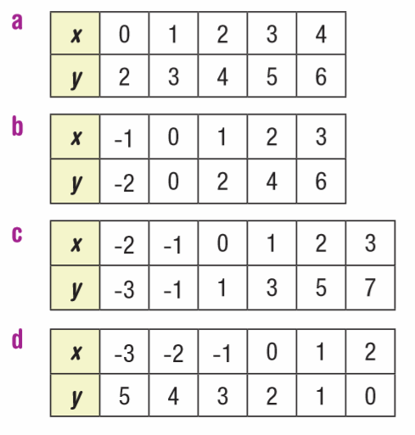
Find a rule in the form y= mx + c for the following table of values:

Slide 12
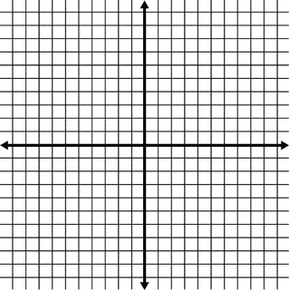

What’s the equation
Remember the gradient $=\frac{rise}{run}$

Slide 13
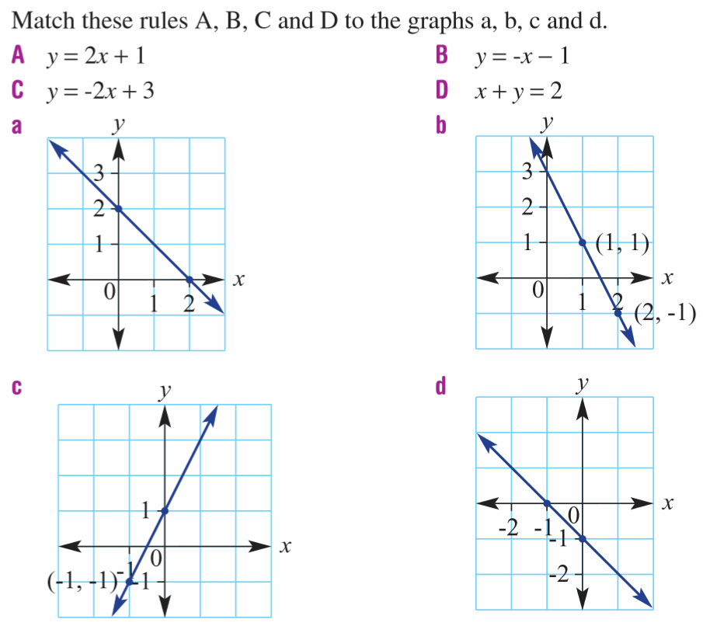

Slide 14
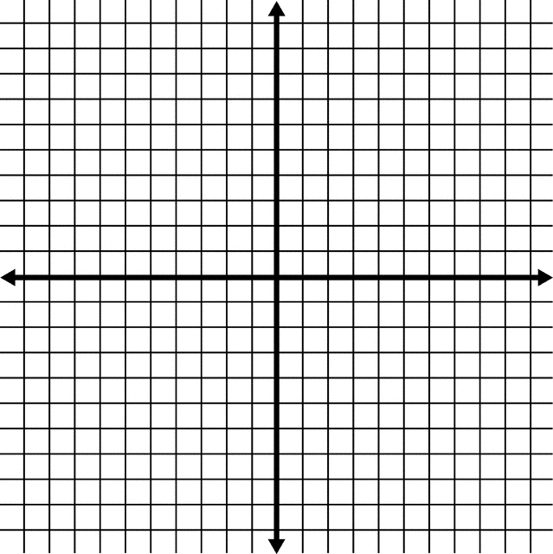
Graph
Pick one of your previous table of values and use it to create a graph on a cartesian plane
GLOSSARY ALERT
Cartesian plane: a plane containing two perpendicular axes, x the horizontal axis and y the vertical axis which intersect at a point called the origin (0,0)

Slide 15
Easiest way to graph
Table of values graphing is VERY time consuming so welcome to the efficient (aka lazy) method of graphing!
Step 1: Solve the equation where y=0
Step 2: Solve the equation where x=0
Step 3: Plot those two points and connect the dots

Slide 16
Lets have a go
y = 3x + 5

Slide 17
Graph these functions
y = 2x+7
x – y=4
2y = 6x+8
x – 3y = 1

Slide 18
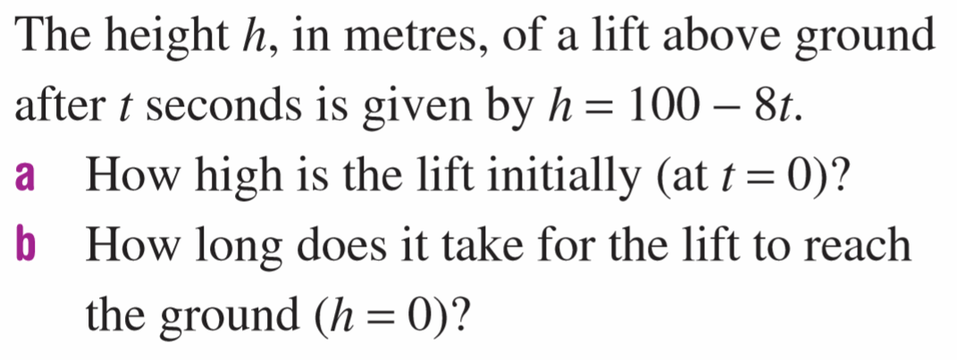
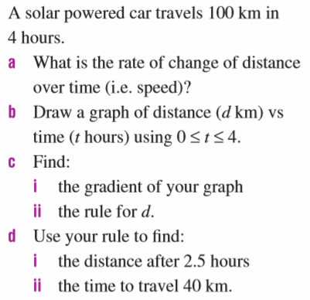
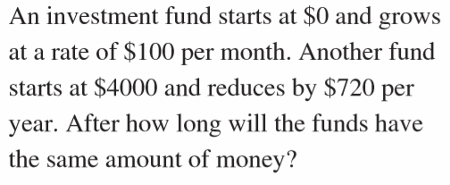
Challenge questions
1
3
2

